Slide 1


GUIDE TO FILLING THE STUDENT LEARNING TIME IN TABLE 4
FOR
UNDERGRADUATE MEDICAL PROGRAMME
Undergraduate Education Subcommittee
Malaysian Medical Council
Notes:
Salam and Hi. This video is prepared to guide higher education provider in filling the student learning time in Table 4 for undergraduate medical programme.

Slide 2
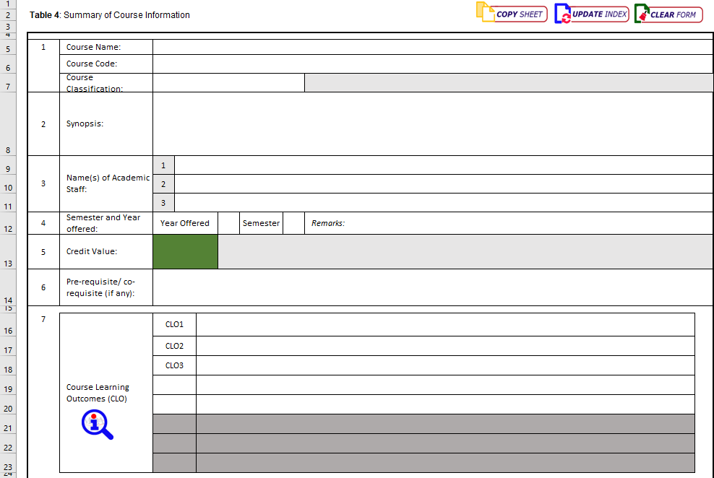
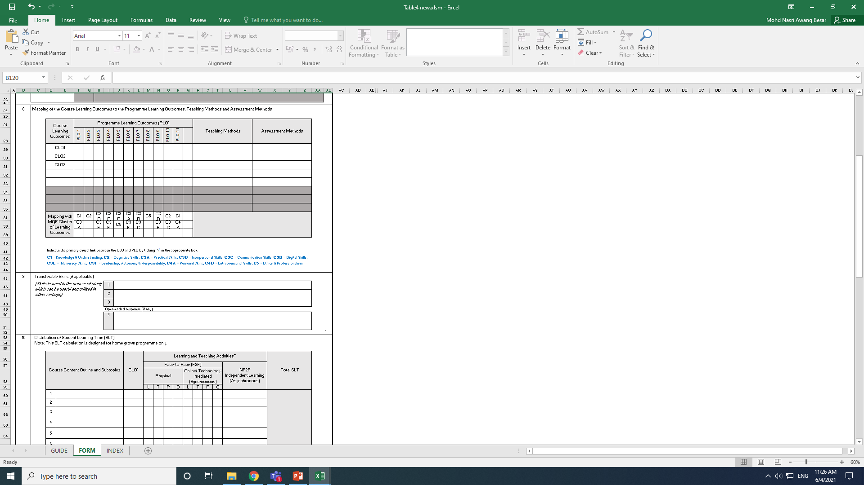
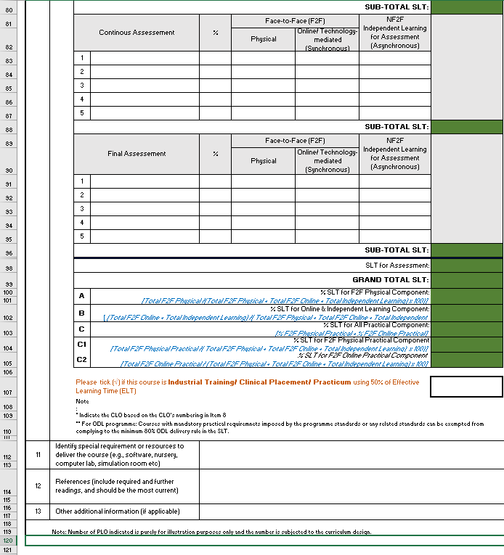
13 items in Table4
Notes:
Table 4 is the summary of course information. There are 13 items in Table 4 that need to be filled.

Slide 3
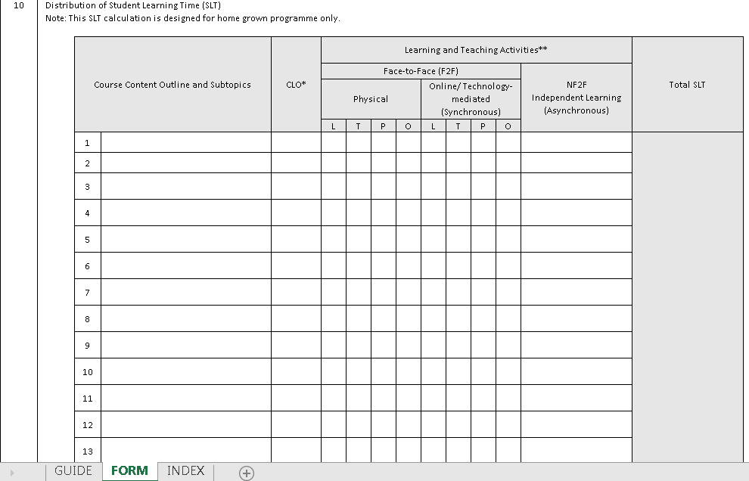
Item 10
Notes:
Item 10 is where the distribution of Student Learning Time needs to be documented according to the course content and the teaching and learning activities.

Slide 4
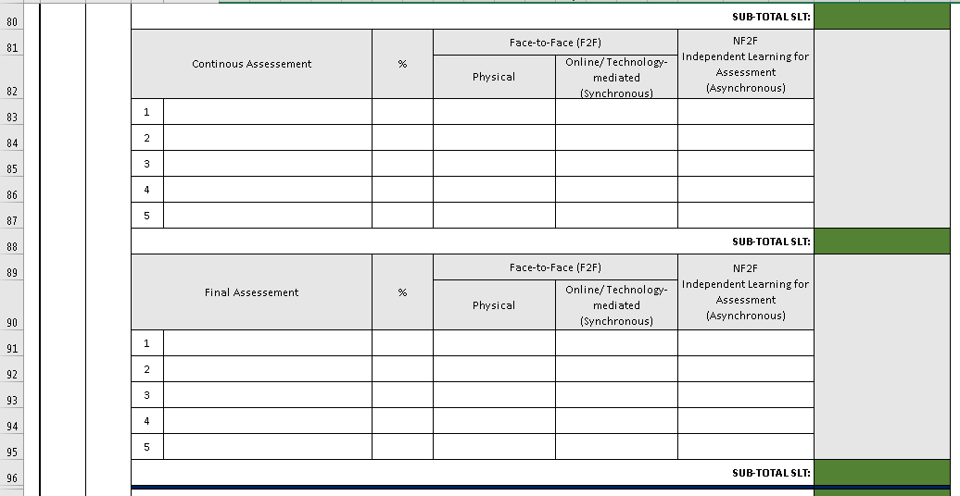
Item 10
Notes:
It also requires a clear description on the continuous, formative and final assessment of the course. Information written on this section must match with the information given in Item 8.

Slide 5

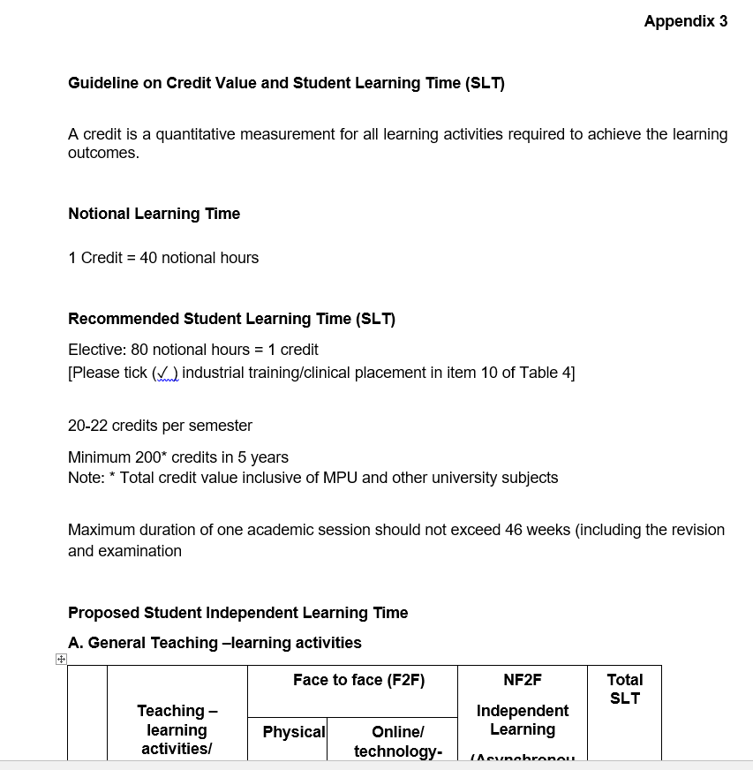
The Proposed Student Independent Learning Time in Appendix 3
STANDARDS FOR UNDERGRADUATE MEDICAL EDUCATION
Notes:
The Guideline on Credit Value and Student Learning Time is available in the Standards for undergraduate medical education as Appendix 3.

Slide 6
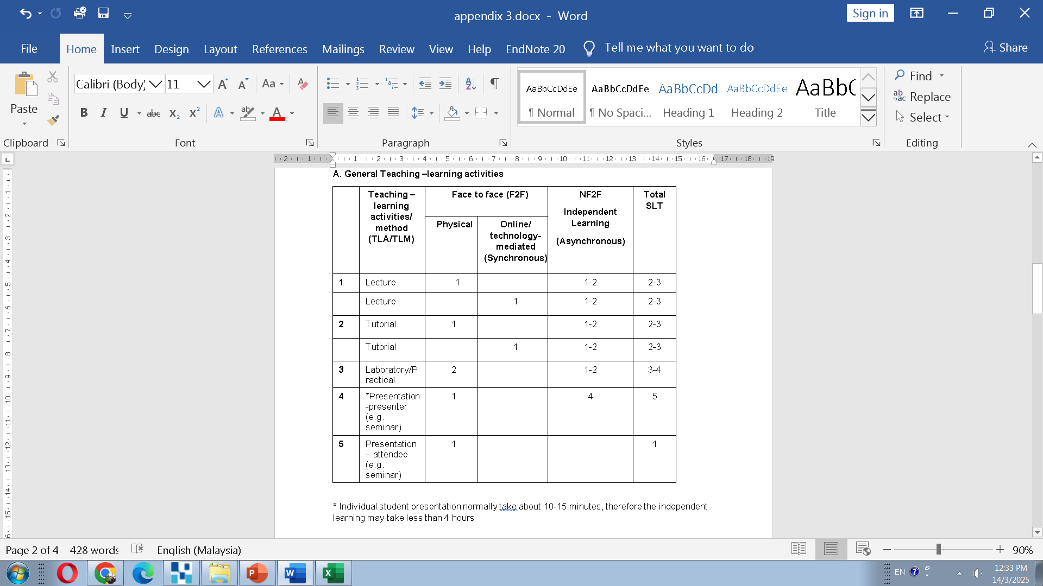
Independent learning (IL) for teaching and learning activities
A particular attention needs to be given to seminar presentation.
For a 1H seminar,
  The seminar presenter is given 1H F2F and 4H IL accordingly.
  Commonly, a student will only present around 10-15 minutes. Therefore, if we take a 15 minutes presentation, the F2F SLT for the presenter will be 0.25H and the IL will be 1H.
  The seminar attendee is given 1H F2F SLT only, without IL as they only listen to the presentation.
Notes:
The SLT guideline has been categorized into 4 sections. In Section A, the guide is on general teaching and learning activities. A one-hour lecture and 1H tutorial has 1H of F2F contact and 1-2H of independent learning according to the difficulty of the content taught. It has the same SLT whether it is delivered physically or through a synchronous online session. Therefore, the total SLT for 1H lecture or tutorial is 2-3H. A particular attention needs to be given to seminar presentation. For a 1H seminar, the attendee is given 1H F2F SLT only, without independent learning as they only listen to the presentation. The presenter is given 1H F2F and 4H independent learning accordingly. However, commonly, a student will only present around 10-15 minutes. Therefore, if we take a 15 minutes presentation, the F2F SLT for the presenter will be 0.25H and the independent learning will be 1H. This seminar SLT calculation will again be highlighted in the simulation at the end of this recording.

Slide 7
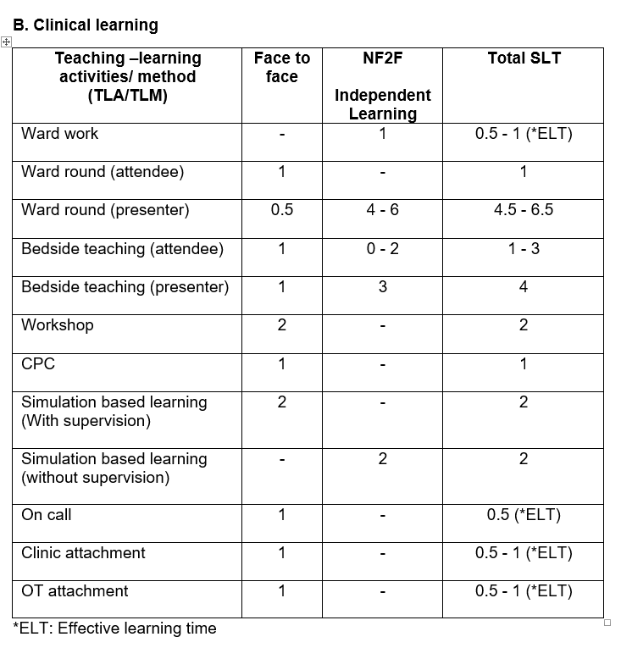
Independent learning (IL) for Clinical learning
Please take note that some activities has only the F2F SLT and some others has only the IL SLT.
Only ward round presenter has both the F2F and IL SLT. This is only written in Table 4 when each student is required to present during ward round through out the posting.
For ward work, on-call, clinic and OT attachment, the SLT is written as the total effective learning time. For example, if the students are required to do a 5H on call once throughout the posting, the SLT written in Table 4 is 2.5 instead of 5.
Notes:
In section B, the guide is on clinical learning activities. Please take note that some activities has only the F2F SLT and some others has only the independent learning SLT. Ward round and bedside teaching presenter have both the F2F and independent learning SLT. This is only written in Table 4 when every student is required to present during ward round and bedside teaching throughout the posting. Bedside teaching attendee is given an independent learning only when the students are given the diagnosis prior to the session and expected to read before attending the session. For ward work, on-call, clinic attachment and OT attachment, the SLT is written as the total effective learning time. For example, if the students are required to do a 5H oncall once throughout the posting, the SLT written in Table 4 is 2.5 instead of 5.

Slide 8
Deciding on the range for ELT
MQA-GGP WBL: Work-based learning (WBL) courses can consider the effective learning time (ELT) of the students at their workplace to be between 50% and 80% of the delivery of the theory, industrial guidance (IG) and workplace assessment.
During ward work, clinic or OT attachment,
  If minimal or no guidance is provided HEP should use 0.5 as the ELT.
  If students are properly supervised (for e.g by clinical instructor or lecturer), then HEP can use 1 as the ELT.
Notes:
How do you decide when to use 0.5 or 1 to calculate the Effective Learning Time?

Slide 9
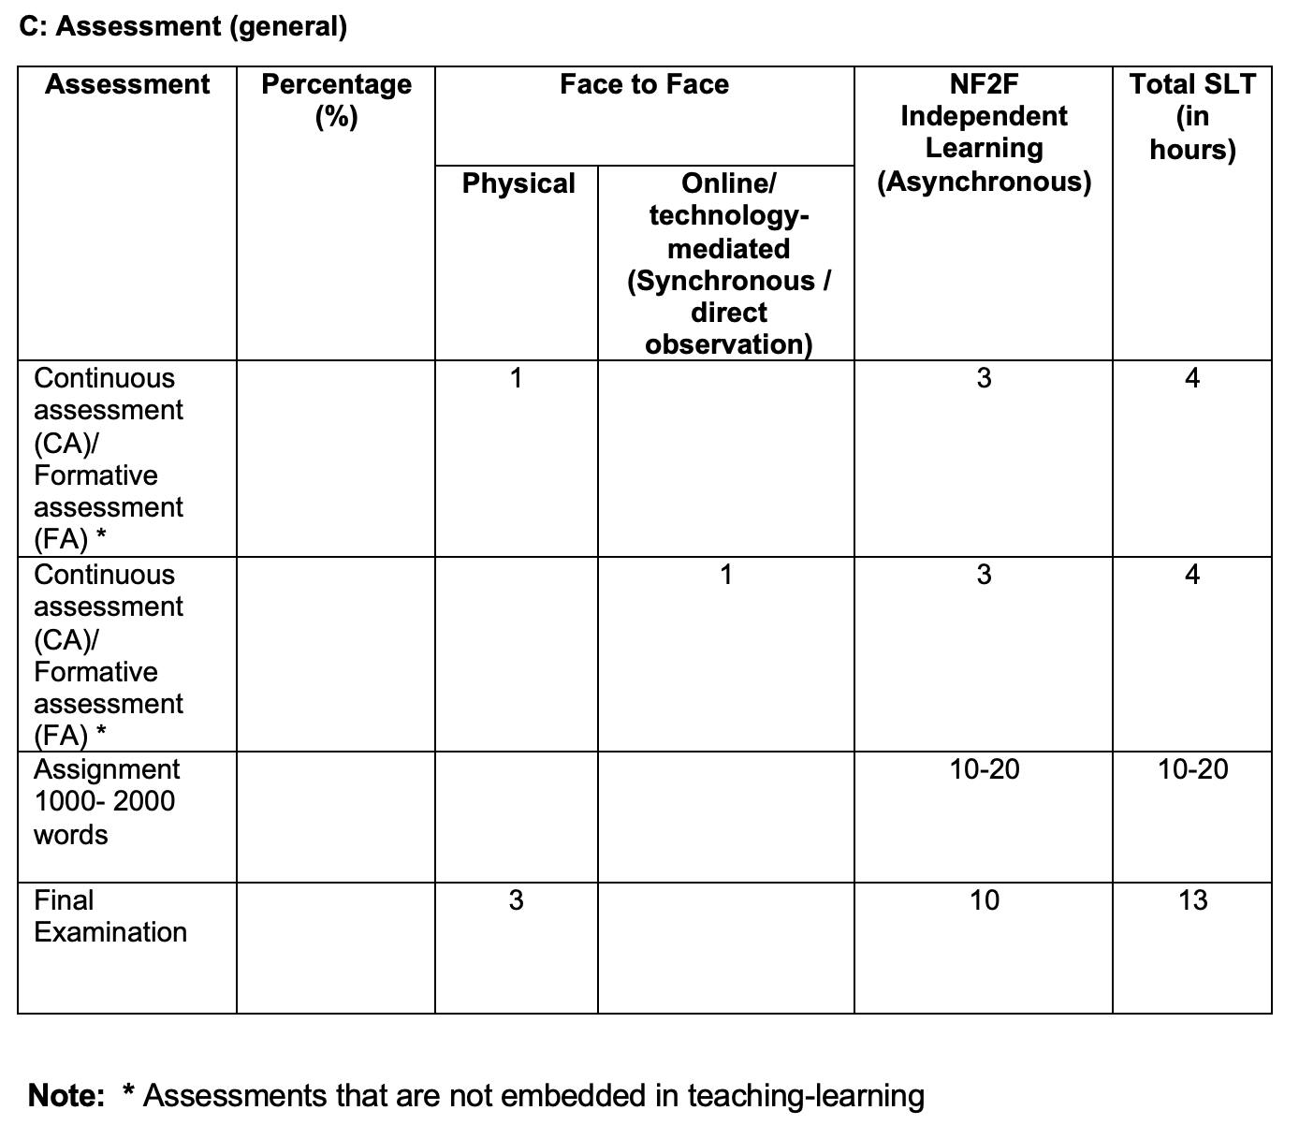
Independent learning (IL) for assessment (General)
For assessments that are not embedded in teaching learning activities, 1H Continuous or Formative Assessment is given 3H of IL.
For the Final Examination, a 3H F2F examination is given a 10H IL.
Please calculate accordingly if your examination is shorter or longer in duration.
A 1000 – 2000 words assignment is given a 10-20 IL SLT. Please calculate accordingly, if your assignment is longer or shorter.
Notes:
Section C is a guide on the SLT for general assessment. 1H CA or FA is given 3H of independent learning while for the final examination, a 3H F2F exam is given a 10H independent learning. Please calculate accordingly if your examination is shorter or longer in duration. A 1000 - 2000 words assignment is given 10-20H of independent learning accordingly.

Slide 10
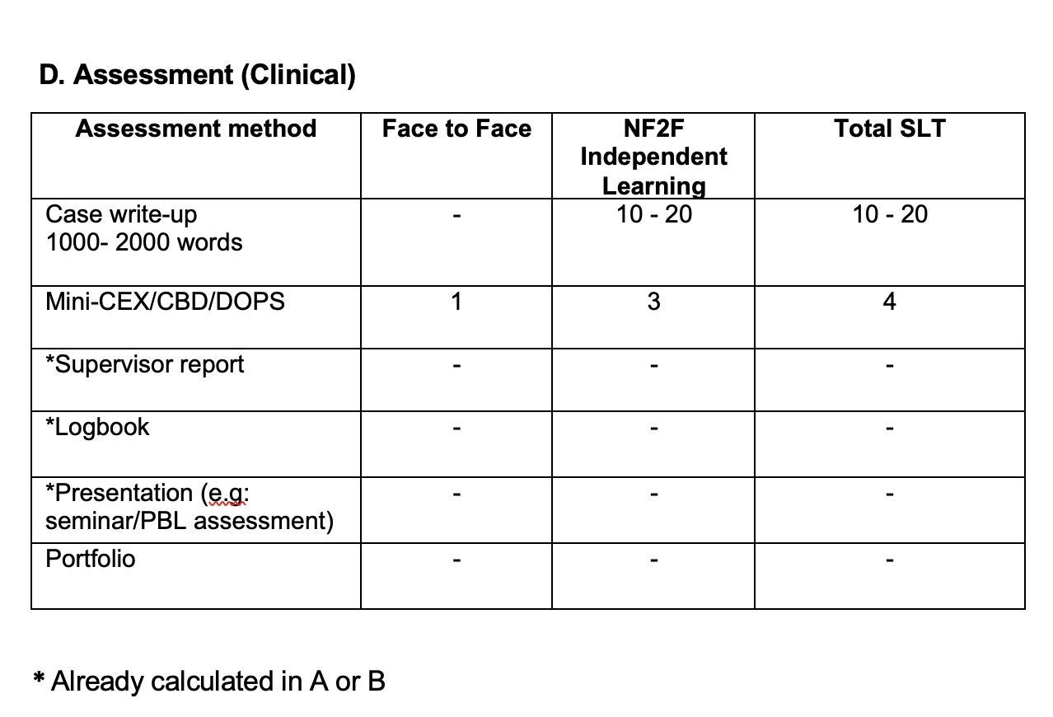
Independent learning (IL) for assessment (Clinical)
The SLT for case write-up is 10H for every 1000 words. Calculate accordingly if your case write up in longer or shorter.
Mini CEX/CBD or DOPS is given the same SLT ratio as continuous/ formative assessment.
Please take note that assessment that is conducted during teaching and learning activities (A)/ Clinical learning (B), as highlighted by the red box, is not given any further SLT to prevent double counting.
Notes:
Section D guide the writing of SLT for clinical assessment. The SLT for case write up is 10H for every 1000 words. Mini CEX/Case based discussion or DOPS is given the same SLT ratio as continuous / formative assessment. Please take note that assessment that is conducted during teaching and learning activities, as highlighted by the red box, is not given any further SLT to prevent double counting.

Slide 11
SIMULATION ON COMPELETING STUDENT LEARNING TIME (SLT) IN ITEM 10 OF TABLE 4

Slide 12
Item 2 of Table 4: Synopsis of the course A
This six (6) weeks course in Year 3 introduces students to various common medical disorders of both acute and chronic illnesses. It emphasises on the aetiology, risk factors, symptoms and signs. It also provides students with skills to take clinical history, perform physical examinations, and identify required initial basic investigations. The teaching, learning, and training will be conducted at the clinical learning site, seminar room and Hospital A's Medical Department. The teaching and learning methodology includes lectures, seminars, skill lab sessions, case based learning and clinical placements for Ward rounds, ward work, bed-side teaching, on calls and attending outpatient clinics. Students will be assessed at the end of this posting by a theory (OBA & KFQ) and performance examination (OSCE & LC). The student must submit a logbook and a case write-up as part of the continuous assessment.

Slide 13
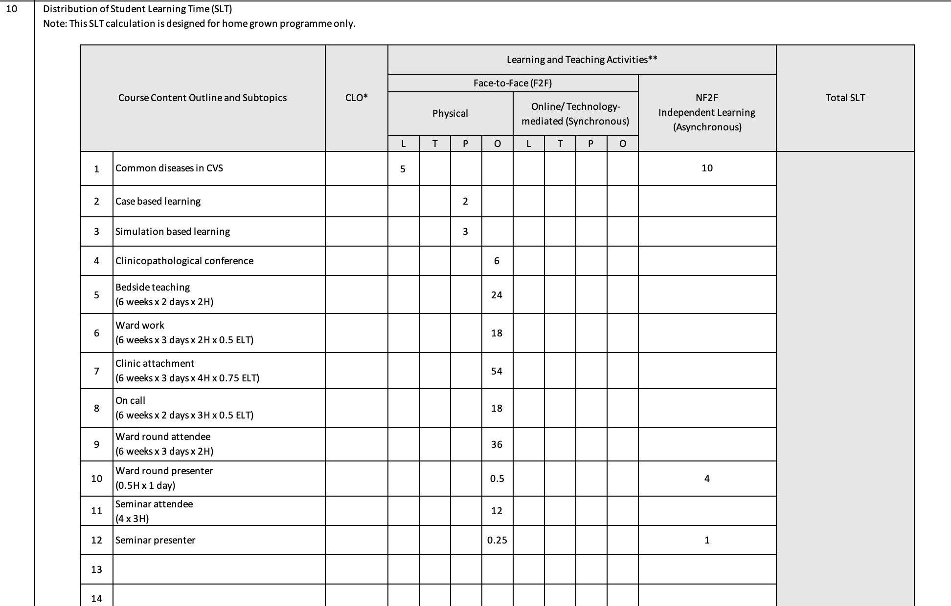
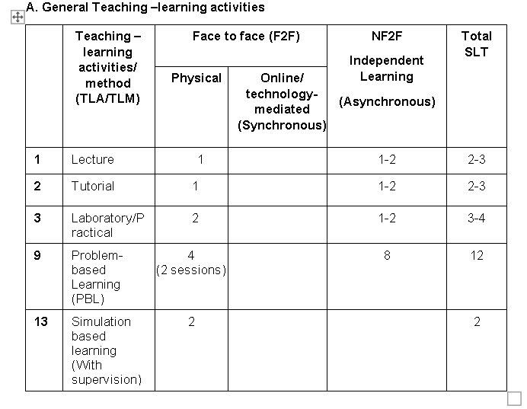
4
Bedside teaching (Presenter)
1
4
(Attendee)
48
Notes:
This is an example of how the teaching and learning activities should be filled in Table 4, based on the course synopsis of the previous slide. The SLT have been calculated according to the guide in section A and B.

Slide 14
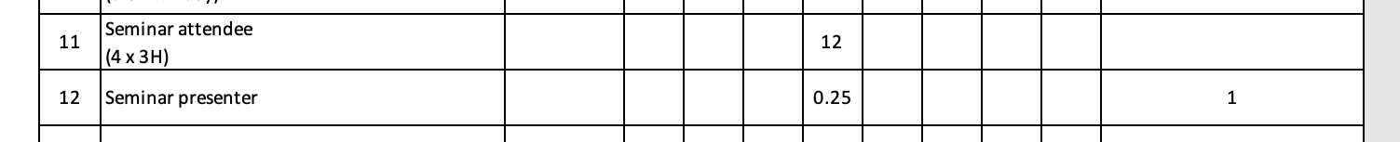
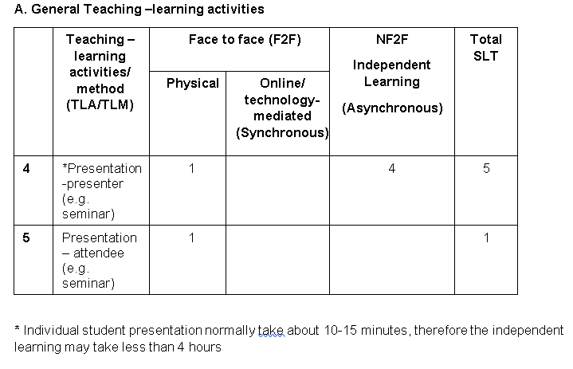
*Seminar as presenter
* Each student in each group presents for 15 minutes (0.25H), therefore the independent learning is 0.25H x 4 IL = 1 hour
Notes:
This is how the calculation for seminar attendee and presenter should be filled in Table 4 based on the guide.

Slide 15
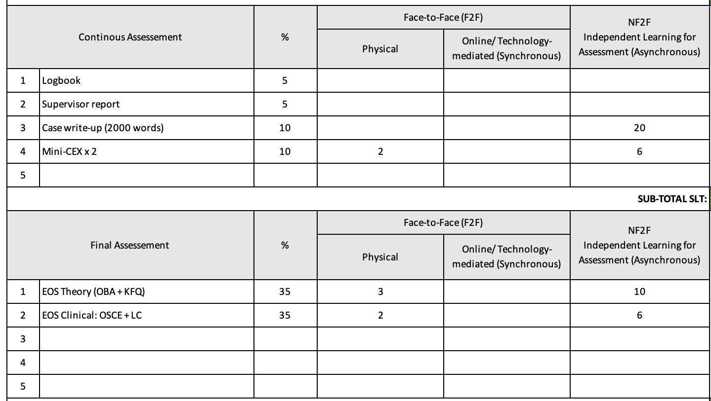
* The SLT for logbook, supervisor report and portfolio has already been calculated in ward work, ward rounds, on calls, clinics and OT attachments,
Notes:
The SLT for logbook, supervisor report and portfolio has already been calculated in the ward work, ward rounds, on calls, clinics and OT attachment. Therefore, in the assessment section, no more SLT is calculated to prevent double counting, as highlighted by the blue box.

Slide 16
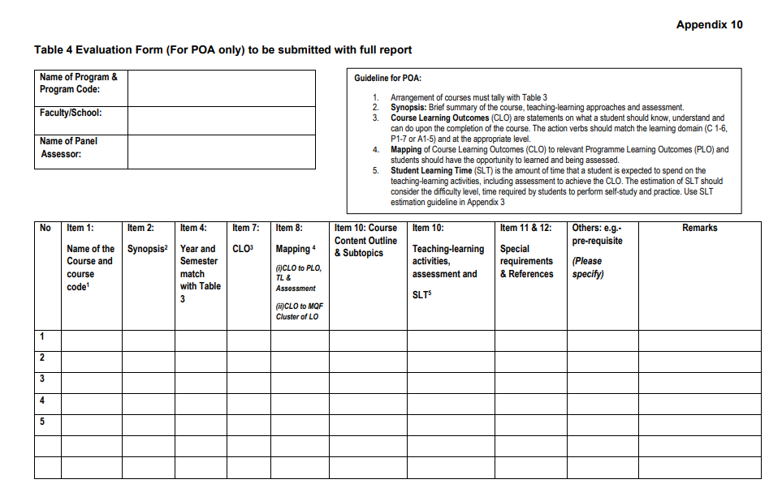
HOW TO EVALUATE YOUR TABLE 4
Notes:
HEP can use Table 4 evaluation Form in Appendix 10 of the standards to check whether they have filled in all the required information for Table 4.

Slide 17

Undergraduate Education Subcommittee
Prof. Dato’ Dr. Mafauzy bin Mohamed – Chair
Dr. Mohd Nasri bin Awang Besar – Co-Chair
Prof. Dr. Adinegara Lutfi Abas
Prof. Madya Dr. Suhaila Sanip
Prof. Dr. Lela Su’ut
Prof. Dato’ Dr. Anas Sjahroeddin Ressang
Prof Madya Dr Sivakumar a/l Thurairajasingam
MMC Secretariat
Notes:
This guide is made possible by the undergraduate education subcommittee and MMC secretariat for Malaysian Medical Council.

